Slide 1
WEB BASED TRAVEL GUIDE
2AV
Name | Student ID | Major
Kumaran A/L M Ragunathan | 1181302809 | A.I.
Tay Hong En | 1191101392 | S.T.
Loo Chuan Wei | 1201301033 | S.T.
Cheong Ji Xiang | 1201300548 | S.T.

Slide 2
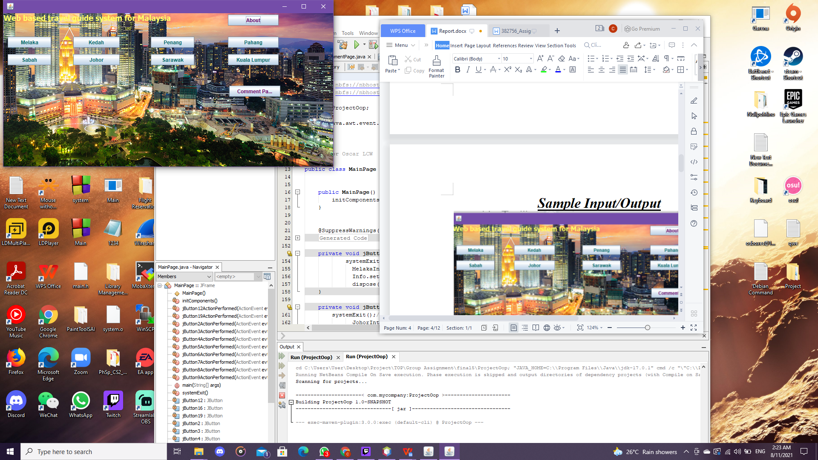
INTRODUCTION
When self-guided tour, you must check all the required information before going.
May encounter many problems, such as the tourist attractions are not open, the location and the previous check the difference.
Need a way to find all the correct information when you travel.

Slide 3
Purpose/Feature
WEB BASED TRAVEL GUIDE
The app is giving all the tourist attractions, restaurant and accommodation. all over Malaysia.
Show the information of all places given include: introduction, addresses, opening hours, phone numbers.
Have some picture of the place for the user to compare and confirm.
If need more information about the related to the locations there also provide the official website or contact of that place

Slide 4
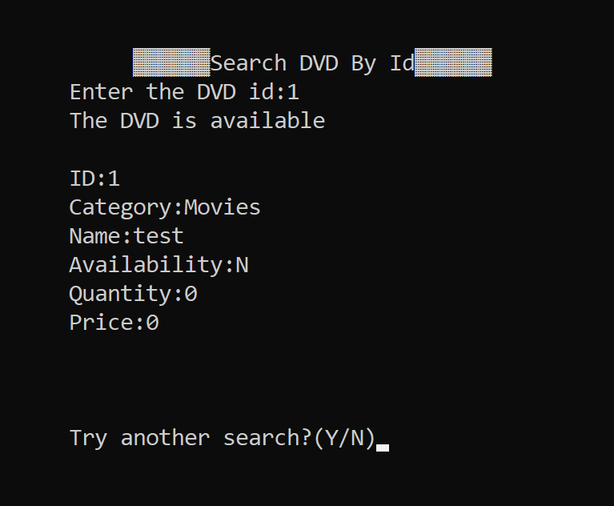
Algorithm
Linear Search
Starting at the beginning of the data set, each item of data is examined until a match is made.
Because there are many ID from all DVD, but for the DVD ID will be only 1 for each id so use this method to find the match result.

Slide 5
DEMO PART

